Slide 1
Nonclassicality, quasiprobabilities and weak values explored in neutron interferometry
Ismaele Vincent Masiello
Neutron and Quantum Physics
Atominstitut
TU Wien, Austria

Slide 2
Disclaimer
Weak values, weak measurements and weak interactions are not related to the weak force!

Slide 3
Overview
Introduction
Nonclassicality
5 min break for questions
Quasiprobabilities and weak values
Experimental results

Slide 4
Introduction

Slide 5
Motivation and goal
Quantum mechanics exhibits features with no classical counterpart.

Slide 6
Motivation and goal
Quantum mechanics exhibits features with no classical counterpart.
However, not all quantum mechanics is non-classical and identifying the classical/quantum boundary is of importance.

Slide 7
Motivation and goal
Quantum mechanics exhibits features with no classical counterpart.
However, not all quantum mechanics is non-classical and identifying the classical/quantum boundary is of importance.
We are interested in experimental tools to probe such boundaries.

Slide 8





Neutron interferometry
Neutron Mach-Zehnder interferometer:
Neutron

Slide 9
Neutron interferometry
Neutron Mach-Zehnder interferometer:
Path
superposition
2
1

Slide 10
Neutron interferometry
Neutron Mach-Zehnder interferometer:
Phase shift

Slide 11
Neutron interferometry
Neutron Mach-Zehnder interferometer:
Path
recombination
?
?

Slide 12
Neutron interferometry
Neutron Mach-Zehnder interferometer:
Interference

Slide 13
Neutron interferometry
Why neutron interferometry?
Interference is intrinsically a single-massive-particle phenomenon.
Matter-wave interferometry at room temperature and ambient pressure, with macroscopic beam separation and high contrast.
Manipulation of several degrees of freedom (path, spin, energy).
Sponar, S., Sedmik, R. I., Pitschmann, M., Abele, H. & Hasegawa, Y. Tests of fundamental quantum mechanics and dark interactions with low-energy neutrons. Nat. Rev. Phys. 3, 309–327 (2021).

Slide 14
Nonclassicality

Slide 15
Preparation and Measurement
Preparation (P)

Slide 16
Preparation and Measurement
Preparation (P)
System

Slide 17
Preparation and Measurement
Preparation (P)
Measurement (M)
1
2
3
...
n
System

Slide 18
Preparation and Measurement
Preparation (P)
Measurement (M)
1
2
3
t
1
2
3
...
n

Slide 19
Preparation and Measurement
Preparation (P)
Measurement (M)
1
2
3
t
1
2
3
...
n
Outcome probabilities:

Slide 20
Preparation and Measurement
Preparation (Pi)
Measurement (Mj)
1
2
3
t
1
2
3
...
n
P3
M2
M3
P2
...
...
P1
Pr
M1
Mm
Outcome probabilities:

Slide 21
A classical experiment
Preparation (Pi)
Measurement (Mj)
1
2
3
...
n
P3
System
M3
P2
...
M2
...
P1
Pr
M1
Mm
Defined set of properties:

Slide 22
A classical experiment
Preparation (Pi)
Measurement (Mj)
1
2
3
...
n
P3
M2
M3
P2
...
...
P1
Pr
M1
Mm
Defined set of properties:

Slide 23
A classical experiment
Preparation (Pi)
Measurement (Mj)
1
2
3
...
n
P3
M2
M3
P2
...
...
P1
Pr
M1
Mm
Defined set of properties:

Slide 24
A classical experiment
Preparation (Pi)
Measurement (Mj)
1
2
t
2
3
...
n
P3
System
M3
P2
...
M2
...
P1
Pr
M1
Mm
100%

Slide 25
A classical experiment
Preparation (Pi)
Measurement (Mj)
1
2
3
...
n
100%
P3
M2
M3
P2
...
...
P1
Pr
M1
Mm

Slide 26
A classical experiment
Preparation (Pi)
Measurement (Mj)
1
2
3
t
2
3
...
n
P3
System
M3
P2
...
M2
...
P1
Pr
M1
Mm
75%
25%

Slide 27
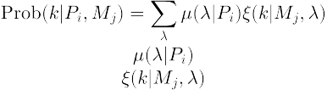
A classical experiment
Probability distribution:
Preparation (Pi)
Measurement (Mj)
1
2
3
t
2
3
...
n
P3
System
M3
P2
...
M2
...
P1
Pr
M1
Mm
75%
25%

Slide 28
A classical experiment
Probability distribution:
Preparation (Pi)
Measurement (Mj)
1
2
3
...
n
25%
75%
P3
System
M3
P2
...
M2
...
P1
Pr
M1
Mm
100%

Slide 29
A classical experiment
Probability distribution:
Response function:
Preparation (Pi)
Measurement (Mj)
1
2
3
...
n
25%
75%
P3
System
M3
P2
...
M2
...
P1
Pr
M1
Mm
100%

Slide 30
A classical experiment
Probability distribution:
Response function:
Outcome probabilities:

Slide 31
A classical experiment
Preparation (P)
Measurement (Mj)
1
2
System
M1
M2
Two properties (shape, color):

Slide 32
A classical experiment
Shape (M1)
Preparation (P)
1
2
1
2
M1
M2
Two properties (shape, color):

Slide 33
A classical experiment
Color (M2)
Preparation (P)
1
2
1
2
M1
M2
Two properties (shape, color):

Slide 34
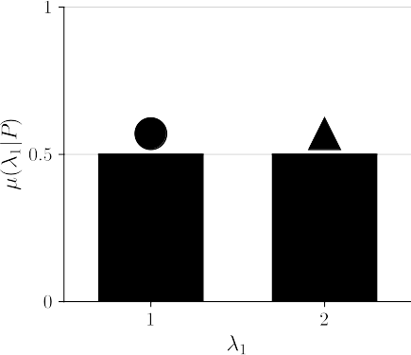
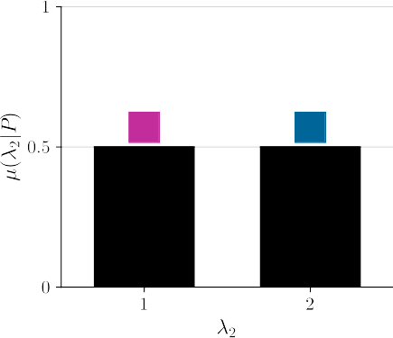
A classical experiment
50%
50%
Outcome probabilities:
50%
50%

Slide 35
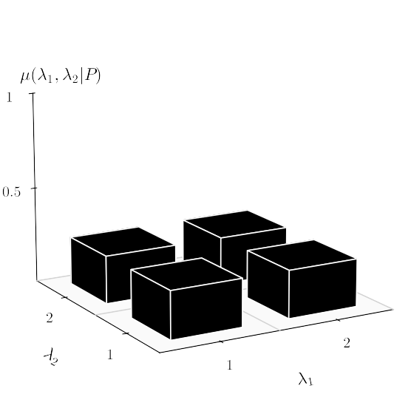
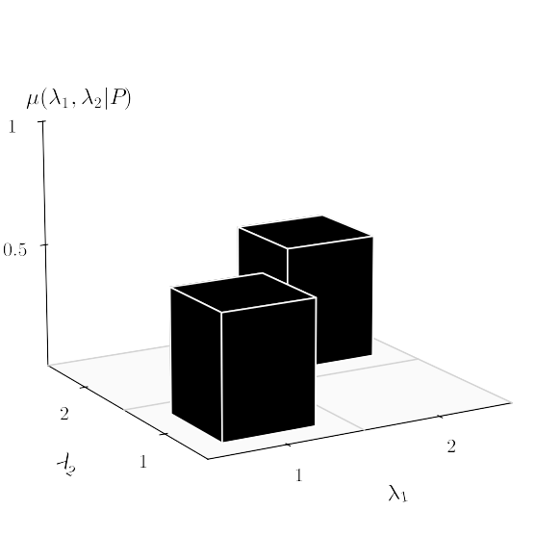
A classical experiment
Probability distribution:

Slide 36
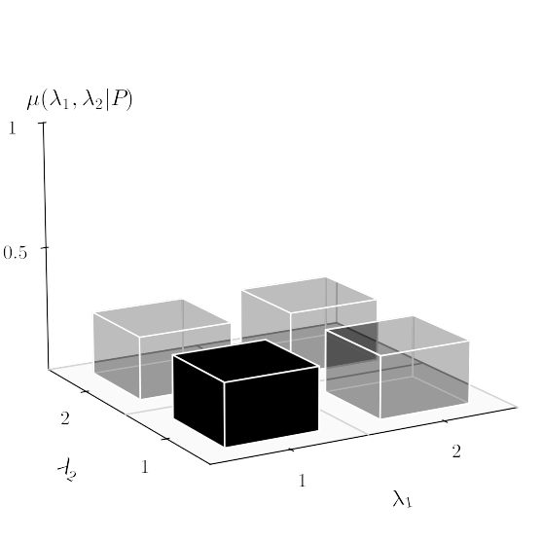
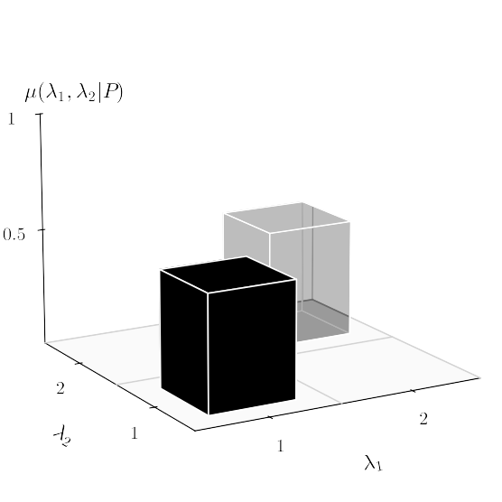
A classical experiment
Probability distribution:

Slide 37
A classical experiment
Sequential (or simultaneous) measurement
1
2
1
2
M1
M2
M1
M2

Slide 38
A classical experiment
Sequential (or simultaneous) measurement
1
2
1
2
M1
M2
M1
M2

Slide 39
A classical experiment
Sequential (or simultaneous) measurement
1
2
1
2
M1
M2
M1
M2
1

Slide 40
A classical experiment
Sequential (or simultaneous) measurement
1
2
1
2
M1
M2
M1
M2
1

Slide 41
A classical experiment
Sequential (or simultaneous) measurement
1
2
1
2
M1
M2
M1
M2
1
2

Slide 42
A classical experiment
Sequential (or simultaneous) measurement
1
2
1
2
M1
M2
M1
M2
1
2
System

Slide 43
A classical experiment
Sequential (or simultaneous) non-disturbing measurement
1
2
1
2
M1
M2
M1
M2
1
2
System

Slide 44
A classical experiment
Outcome probabilities for non-disturbing measurements:

Slide 45
A classical experiment
Outcome probabilities for non-disturbing measurements:

Slide 46

A classical experiment
Outcome probabilities for non-disturbing measurements:

Slide 47


A quantum experiment
Preparation (P)
Measurement (Mj)
1
2
3
...
n
System
Set of undefined properties:

Slide 48
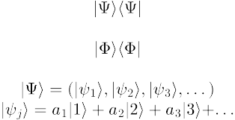
A quantum experiment
Preparation (P)
Measurement (Mj)
1
2
3
...
n
System
Set of undefined properties:
Superposition:

Slide 49
A quantum experiment
Pure state:
Preparation (P)
Measurement (Mj)
1
2
3
...
n
System
100%

Slide 50

A quantum experiment
Pure state:
Projective measurement:
Preparation (P)
Measurement (Mj)
1
2
3
...
n
System
100%

Slide 51

A quantum experiment
Pure state:
Projective measurement:
Preparation (P)
Measurement (Mj)
1
2
3
...
n
25%
75%
Outcome probabilities:

Slide 52
A quantum experiment
Pure state:
Projective measurement:
Preparation (P)
Measurement (Mj)
1
2
3
...
n
25%
75%
Is quantum mechanics secretly classical?
Outcome probabilities:

Slide 53
Is quantum mechanics classical?
Pure state:
Preparation (P)
Measurement (Mj)
1
2
3
...
n
System
100%

Slide 54
Is quantum mechanics classical?
Probability distribution:
Preparation (P)
Measurement (Mj)
1
2
3
t
2
3
...
n
System
75%
25%

Slide 55
Neutron interferometry test of nonclassicality
Neutron
Interferometer:

Slide 56

Neutron interferometry test of nonclassicality
Neutron
Interferometer:
Preparation (P)

Slide 57
Neutron interferometry test of nonclassicality
Neutron
Interferometer:
1
2
Phase
π/4
-π/4
M1
M2
Preparation (P)
Path (M1,M2)

Slide 58
Neutron interferometry test of nonclassicality
Neutron
Interferometer:
1
2
1
2
Phase
Direction
π/4
-π/4
x
y
M1
M2
M3
M4
Preparation (P)
Path (M1,M2)
Spin (M3,M4)

Slide 59
Neutron interferometry test of nonclassicality
Measurements:
M1
M2
M3
M4
1
2
1
2
Phase
Direction
π/4
-π/4
x
y
M1
M2
M3
M4
Preparation (P)
Path (M1,M2)
Spin (M3,M4)

Slide 60

Neutron interferometry test of nonclassicality
Measurements:
M1
M2
Disturbing
M3
M4
1
2
1
2
Phase
Direction
π/4
-π/4
x
y
M1
M2
M3
M4
Preparation (P)
Path (M1,M2)
Spin (M3,M4)

Slide 61

Neutron interferometry test of nonclassicality
Measurements:
M1
M2
Disturbing
Non-disturbing
M3
M4
1
2
1
2
Phase
Direction
π/4
-π/4
x
y
M1
M2
M3
M4
Preparation (P)
Path (M1,M2)
Spin (M3,M4)

Slide 62
Neutron interferometry test of nonclassicality
Measurements:
Measurements:
Measurements:
M1
M2
Disturbing
Non-disturbing
M3
M4
1
2
1
2
Phase
Direction
π/4
-π/4
x
y
M1
M2
M3
M4
Preparation (P)
Path (M1,M2)
Spin (M3,M4)
Noncontextuality
Kochen, S. and Specker, E.P. “The Problem of Hidden Variables in Quantum Mechanics.” Journal of Mathematics and Mechanics, vol. 17, no. 1, 1967, pp. 59–87. JSTOR

Slide 63
Neutron interferometry test of nonclassicality
Outcome probabilities:
?

Slide 64
Neutron interferometry test of nonclassicality
Outcomes correlations:
Clauser–Horne–Shimony–Holt (CHSH) inequality:
J.F. Clauser; M.A. Horne; A. Shimony; R.A. Holt (1969), "Proposed experiment to test local hidden-variable theories", Phys. Rev. Lett., 23 (15): 880–4,

Slide 65

Neutron interferometry test of nonclassicality
Outcomes correlations:
Clauser–Horne–Shimony–Holt (CHSH) inequality:
Eperimental results:
Hasegawa, Yuji, et al. “Violation of a bell-like inequality in single-neutron interferometry.” Nature 425, 45–48 (2003).

Slide 66
Neutron interferometry test of nonclassicality
Outcomes correlations:
Clauser–Horne–Shimony–Holt (CHSH) inequality:
Eperimental results:
Hasegawa, Yuji, et al. “Violation of a bell-like inequality in single-neutron interferometry.” Nature 425, 45–48 (2003).
Geppert, Hermann, et al. "Improvement of the polarized neutron interferometer setup demonstrating violation of a Bell-like inequality." Nuclear Instruments and Methods in Physics Research Section A 763 (2014): 417-423.

Slide 67
Neutron interferometry test of nonclassicality
Is quantum mechanics secretly classical?
...NO!

Slide 68
Neutron interferometry test of nonclassicality
Is quantum mechanics secretly classical?
...NO!
*
*according to our definition of non-disturbance (commutativity)

Slide 69

Bell test of nonclassicality
Measurements:
M1
M2
Disturbing
Non-disturbing
M3
M4
1
2
1
2
Polarization
Polarization
a
b
a
b
M1
M2
M3
M4
Particle 1 (M1,M2)
Preparation (P)
Particle 2 (M3,M4)

Slide 70
Bell test of nonclassicality
Measurements:
M1
M2
Disturbing
Non-disturbing
Separated in space!
M3
M4
1
2
1
2
Polarization
Polarization
a
b
a
b
M1
M2
M3
M4
Particle 1 (M1,M2)
Preparation (P)
Particle 2 (M3,M4)
Locality
Bell, John S. "On the einstein podolsky rosen paradox." Physics Physique Fizika 1.3 (1964): 195.

Slide 71
Bell test of nonclassicality
Experimental result:
Aspect, Alain, et al. "Experimental realization of Einstein-Podolsky-Rosen-Bohm Gedankenexperiment: A new violation of Bell's inequalities." Physical review letters 49.2 (1982): 91.
Quantum mechanics seems to be nonclassical
independently of the quantum model

Slide 72
Break
Questions?

Slide 73

Is quantum mechanics classical?
Outcome probabilities:
?

Slide 74
Quasiprobability representations and weak values

Slide 75
Quasiprobability representations
Quasiprobability representations:

Slide 76



Quasiprobability representations
Quasiprobability representations:
Anomalous features:

Slide 77
Quasiprobability representations
Quasiprobability representations:
Anomalous features:
Ferrie, Christopher. "Quasi-probability representations of quantum theory with applications to quantum information science." Reports on Progress in Physics 74.11 (2011): 116001.
Spekkens, Robert W. "Negativity and contextuality are equivalent notions of nonclassicality." Physical review letters 101.2 (2008): 020401.

Slide 78
Quasiprobability representations
Quasiprobability representations:
Quasiprobability
distribution
Anomalous features:

Slide 79
Quasiprobability representations
Quasiprobability representations:
Quasiprobability
distribution
Symbol
Anomalous features:

Slide 80
Quasiprobability representations
Two orthonormal basis:
Kirkwood-Dirac quasiprobability representation:

Slide 81
Quasiprobability representations
Two orthonormal basis:
Kirkwood-Dirac quasiprobability representation:

Slide 82
Quasiprobability representations
Two orthonormal basis:
Kirkwood-Dirac quasiprobability representation:
Weak value

Slide 83
Quasiprobability representations
Two orthonormal basis:
Kirkwood-Dirac quasiprobability representation:
Weak value
..and we can measure it!

Slide 84
Quasiprobability representations
Two orthonormal basis:
Kirkwood-Dirac quasiprobability representation:
Weak values!
..and we can measure them!

Slide 85

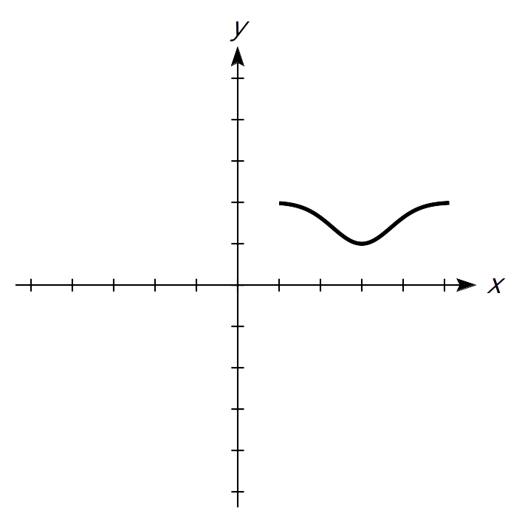
A standard (Von Neumann) measurement
Stern-Gerlach
Spin
Position

Slide 86
A standard (Von Neumann) measurement
Stern-Gerlach
∆t
Spin
Position
N
S

Slide 87
A standard (Von Neumann) measurement
Stern-Gerlach
∆t
Spin
Position
N
Interaction strength
S

Slide 88
A weak measurement
Spin
Position
Aharonov, Yakir, et al. "How the result of a measurement of a component of the spin of a spin-1/2 particle can turn out to be 100." Physical review letters 60.14 (1988): 1351.

Slide 89
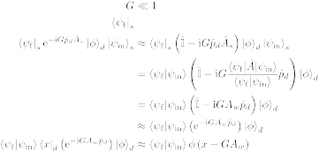
A weak measurement
Weak interaction
Spin
Position
N
S
Aharonov, Yakir, et al. "How the result of a measurement of a component of the spin of a spin-1/2 particle can turn out to be 100." Physical review letters 60.14 (1988): 1351.

Slide 90
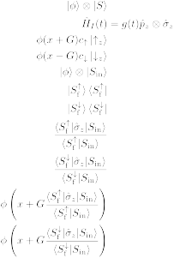
A weak measurement
Weak interaction
Spin
Position
N
Post-selection
N
S
S
Aharonov, Yakir, et al. "How the result of a measurement of a component of the spin of a spin-1/2 particle can turn out to be 100." Physical review letters 60.14 (1988): 1351.

Slide 91
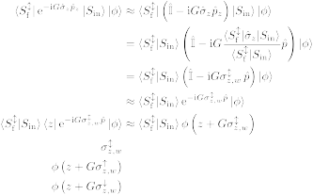

A weak measurement
Weak interaction
Spin
Position
N
Post-selection
N
S
S
Spin weak value:
Aharonov, Yakir, et al. "How the result of a measurement of a component of the spin of a spin-1/2 particle can turn out to be 100." Physical review letters 60.14 (1988): 1351.

Slide 92
Weak values extraction in neutron interferometry
Meter state and weak interaction:
Lemmel, Hartmut, et al. "Quantifying the presence of a neutron in the paths of an interferometer." Physical Review Research 4.2 (2022): 023075.
Danner, Armin, et al. "Simultaneous path weak-measurements in neutron interferometry." Scientific Reports 14.1 (2024): 25994.
Dvorak, Andreas, et al. "Tight qubit uncertainty relations studied through weak values in neutron interferometry." Physical Review Research 7.4 (2025): 043334.
Meter state and no weak interaction:
Denkmayr, Tobias, et al. "Weak values from strong interactions in neutron interferometry." Physica B: Condensed Matter 551 (2018): 339-346.
No meter state and weak interaction:
Masiello, Ismaele V., et al. "Simultaneous determination of two path weak-values with time-dependent phase manipulation in neutron interferometry." New Journal of Physics 27.2 (2025): 023017.

Slide 93
Weak values extraction in neutron interferometry
Meter state and weak interaction:
Lemmel, Hartmut, et al. "Quantifying the presence of a neutron in the paths of an interferometer." Physical Review Research 4.2 (2022): 023075.
Danner, Armin, et al. "Simultaneous path weak-measurements in neutron interferometry." Scientific Reports 14.1 (2024): 25994.
Dvorak, Andreas, et al. "Tight qubit uncertainty relations studied through weak values in neutron interferometry." Physical Review Research 7.4 (2025): 043334.
Meter state and no weak interaction:
Denkmayr, Tobias, et al. "Weak values from strong interactions in neutron interferometry." Physica B: Condensed Matter 551 (2018): 339-346.
No meter state and weak interaction:
Masiello, Ismaele V., et al. "Simultaneous determination of two path weak-values with time-dependent phase manipulation in neutron interferometry." New Journal of Physics 27.2 (2025): 023017.

Slide 94
Weak values extraction in neutron interferometry
Meter states or weak interactions increase
the experimental complexity!
The manipulation of additional degrees of freedom increases the amount of required experimental resources (additional instrumentation and procedures), while weak interactions typically necessitate longer measurement times due to the limited information gained per detection event.

Slide 95
Weak values extraction in neutron interferometry
Meter states or weak interactions increase
the experimental complexity!
The manipulation of additional degrees of freedom increases the amount of required experimental resources (additional instrumentation and procedures), while weak interactions typically necessitate longer measurement times due to the limited information gained per detection event.
No meter state and no weak interaction:
Masiello, Ismaele V., et al. "Anomalous weak values in a generalized Mach-Zehnder interferometer extracted directly from intensity measurements." in review at npj Quantum Information.

Slide 96
Brief experimental results
Unexpectedly running out of time :(

Slide 97
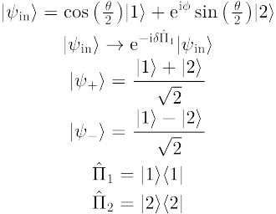
Weak values from output intensities
Initial state:
Neutron Mach-Zehnder
interferometer:
Path observable:
2
1

Slide 98
Weak values from output intensities
Initial state:
Generalized neutron
Mach-Zehnder interferometer:
Path observable:
Phase shift:

Slide 99
Weak values from output intensities
Initial state:
Generalized neutron
Mach-Zehnder interferometer:
Path observable:
Phase shift:
-
+
Final states:

Slide 100
Weak values from output intensities
Initial state:
Generalized neutron
Mach-Zehnder interferometer:
Path observable:
Phase shift:
Final states:
Measured intensity:

Slide 101

Weak values from output intensities
Initial state:
Generalized neutron
Mach-Zehnder interferometer:
Path observable:
Phase shift:
Final states:
Path weak-values:
Measured intensity:

Slide 102
Weak values from output intensities
Generalized neutron
Mach-Zehnder interferometer:
Weak values can be
directly extracted from
the output intensities!
Path weak-values:

Slide 103
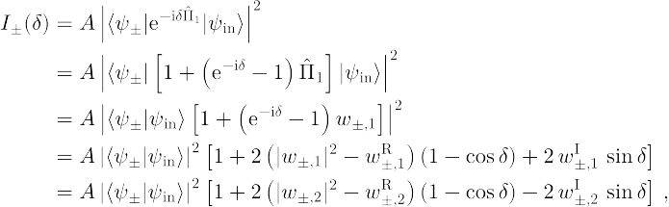
Weak values from output intensities
Measured intensity:
Amplitude
squared
Real
part
Imaginary
part

Slide 104
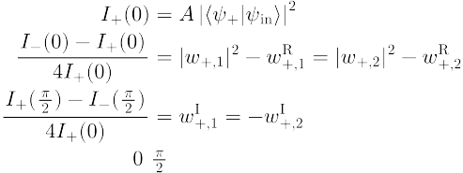

Weak values from output intensities
Three measurements settings:

Slide 105
Weak values from output intensities
Three measurements settings:

Slide 106
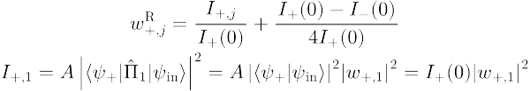
Weak values from output intensities
Three measurements settings:

Slide 107
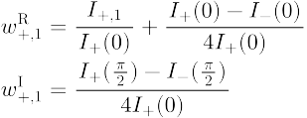
Weak values from output intensities
Weak value extraction:

Slide 108
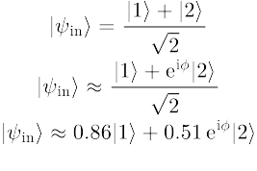
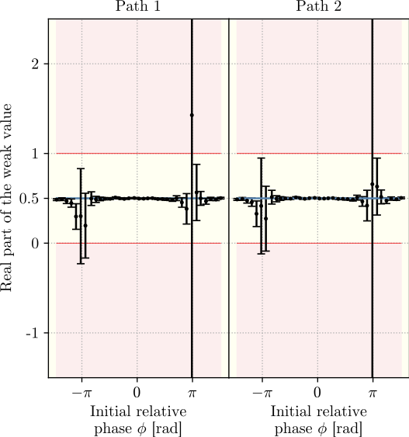
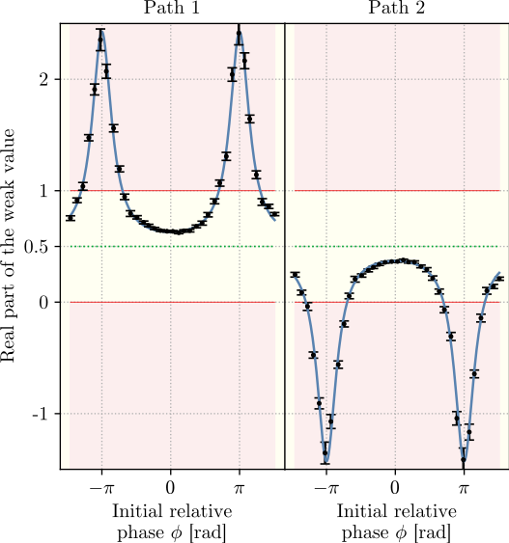
Weak values from output intensities
Balanced:
Unbalanced:

Slide 109
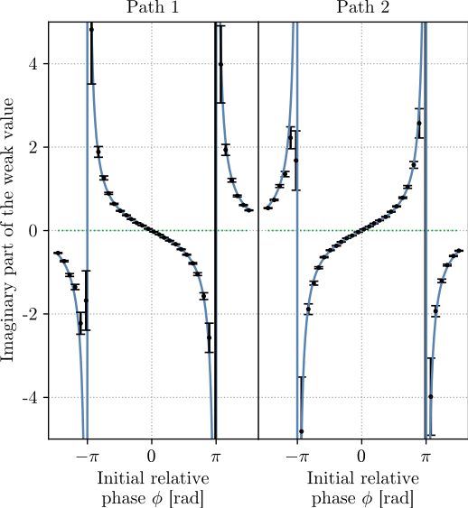
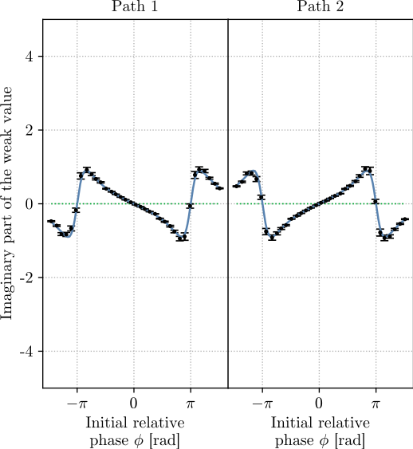
Weak values from output intensities
Balanced:
Unbalanced:

Slide 110
Weak values from output intensities
Blocker
Required setup:
Interferometer
Path blocker
Phase shifter
Measurements:
No meter state and no weak interaction (shorter acquisition times with comparable or improved precision)
3 measurements needed to completely determine the path weak-values

Slide 111
Weak values from output intensities
Bonus experimental result!
Three-path neutron interferometer:
3
2
1

Slide 112

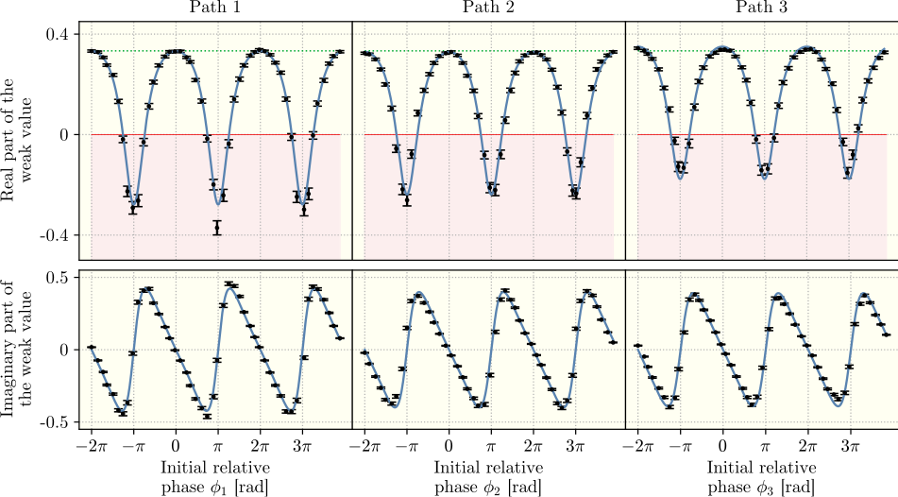
Weak values from output intensities
Initial state:

Slide 113
Summary
Quantum mechanics is nonclassical, but not always
Weak values can be used to identify nonclassical phenomena
Our group developed several methods to extract weak values in neutron interferometry
In particular, one method that requires no weak interaction and no meter state was presented. The method can be applied any N-level quantum system in which alike measurements can be performed.

Slide 114
Neutron Interferometry Group
Yuji Hasegawa (Professor/supervisor)
Stephan Sponar (Professor)
Hartmut Lemmel (Instrument responsible)
Andreas Dvorak (PhD student)
Florian Engel (PhD student)
Kazuma Obigane (PhD student)

Slide 115
Thank you for your attention!

